Slide 1
Cerebrovascular Diseases
Guided by-Dr Arpitha mam

Slide 2
Stroke Defn-
It is defined as an abrupt onset of a neurological deficit due to focal vascular cause where signs & symptoms last for >24 hrs or radiological evidence of infarction
Neurological symptoms are manifested within seconds as because neurons lack glycogen, so energy failure is rapid
It is 2nd leadind cause of death worldwide

Slide 3
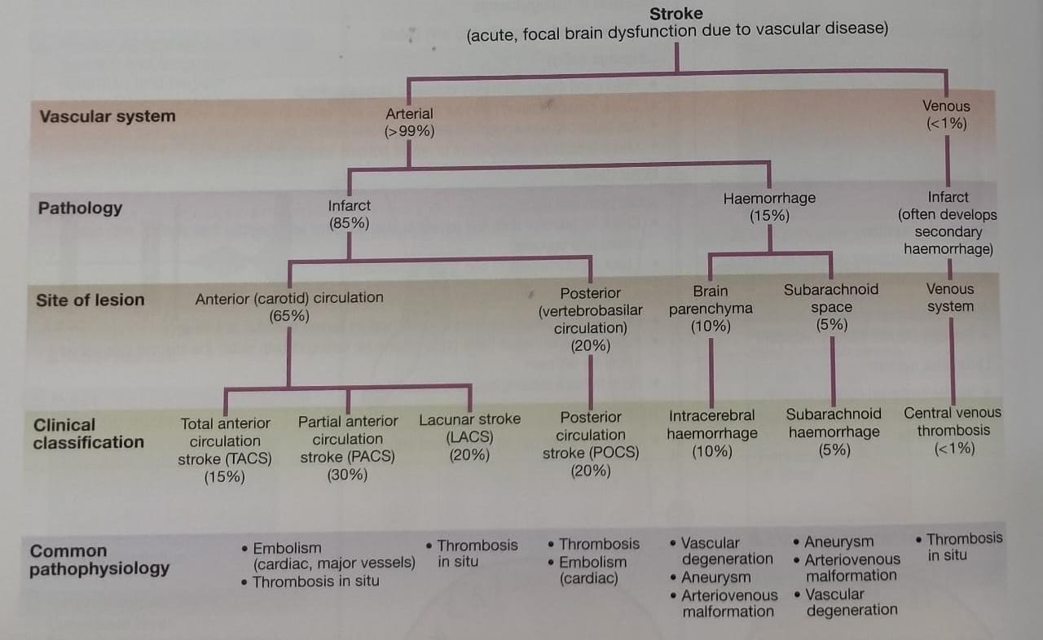

Slide 4
Approach to patient
pt complaints of loss of sensory & motor function on one side body, change in vision, gait,ability to speak/understand or sudden severe headache
FAST(facial wkn,arm wkn,speech abnormality & time)

Slide 5
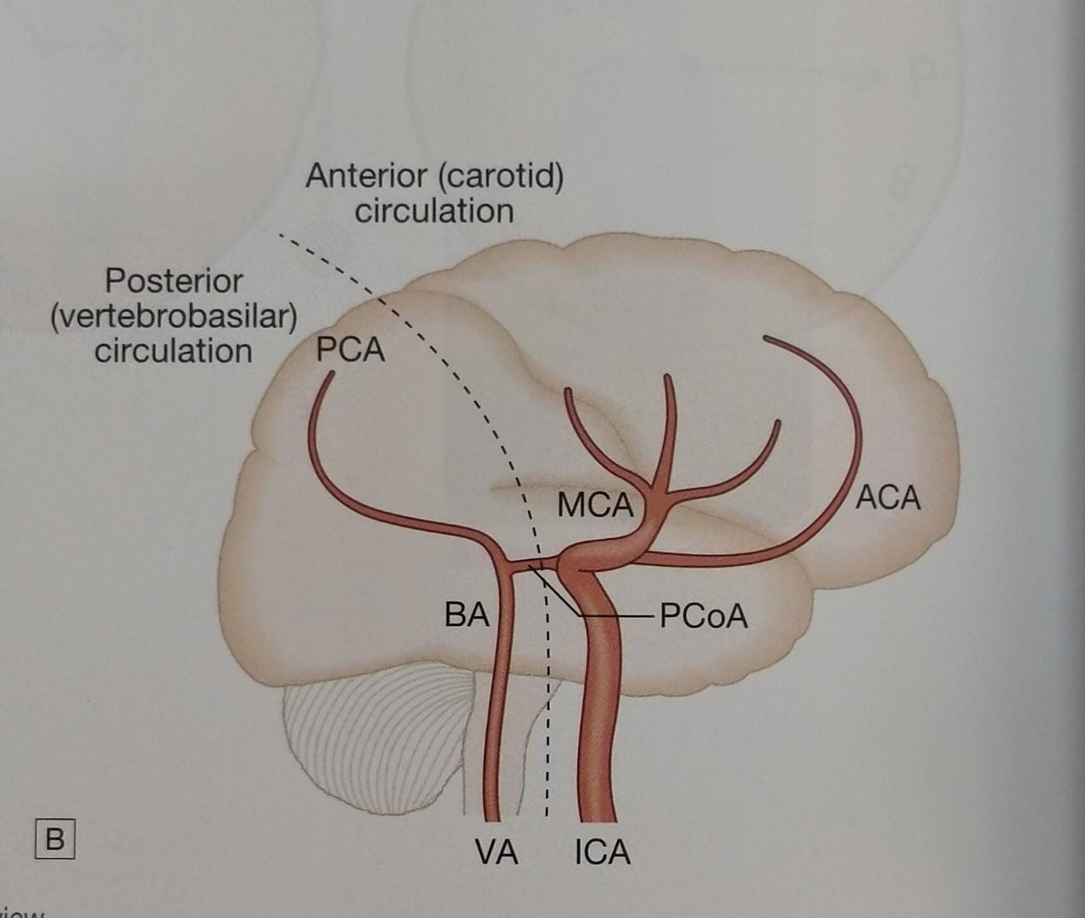
Stroke syndromes:
Divided into-1)large vessel stroke in anterior circulation
2)large vessel stroke in posterior circulation
3)small vessel sroke

Slide 6
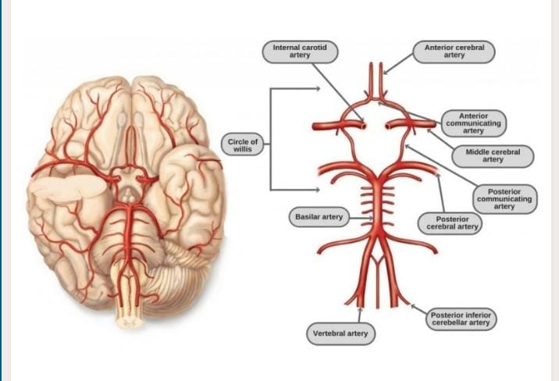
A2
A1
p2
p1

Slide 7
Anterior circulation-
-it is by ICA and its branches which include MCA,
ACA, anterior choroidal artery mainly
-these vessels are occluded by intrinsic diseases of the vessel (eg: atherosclerosis,dissection) or by embolus from proximal source
-occlusion of each vessel has distinct clinical manifestations

Slide 8
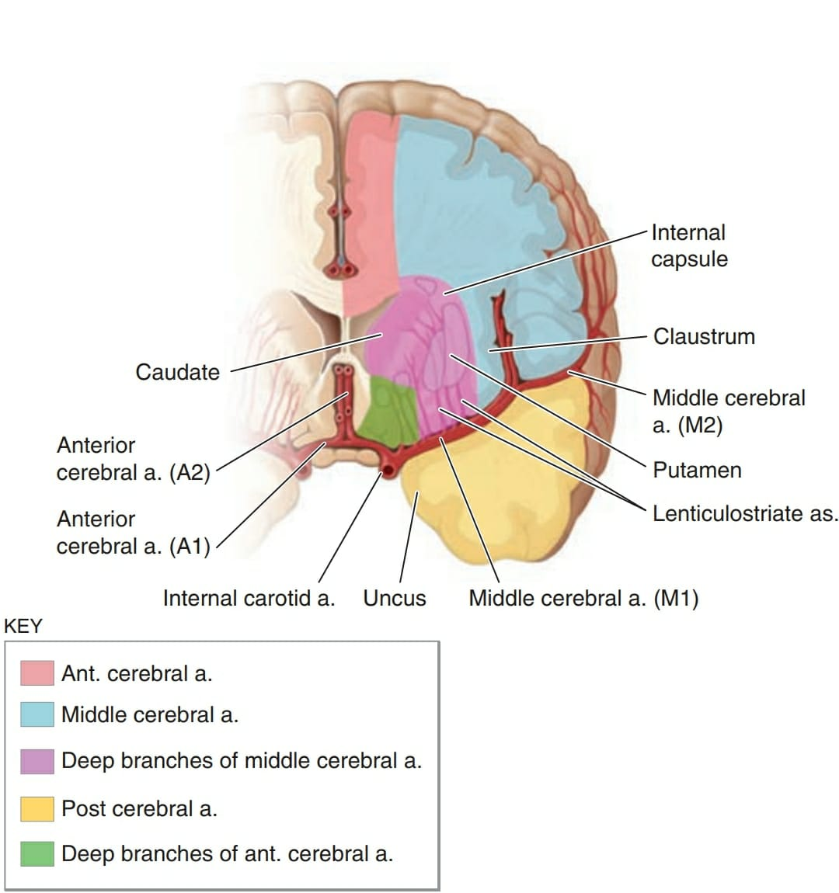

Slide 9
Middle cerebral artery-
-occlusion is often due to embolus than intracranial atherosclerosis
-MCA supplies lateral surface surface of hemisphere
-Stem-C/L hemiplegia,hemisensory loss,homonymous hemianopia, global aphasia(dominant lobe)
-M1 segment(proximal) gives rise to penetrating branches(Lenticulostriate branches) which supply putamen,globus pallidus,posterior limb of IC,corona radiata & caudate nucleus Lacunar stroke(smallvesl)
-In sylvian fissure
M2 sup-frontal lobe-c/l hemiplegia,broca aphasia,
SMILE
inf-temporal lobe-no weakness,wernickes aphasia

Slide 10
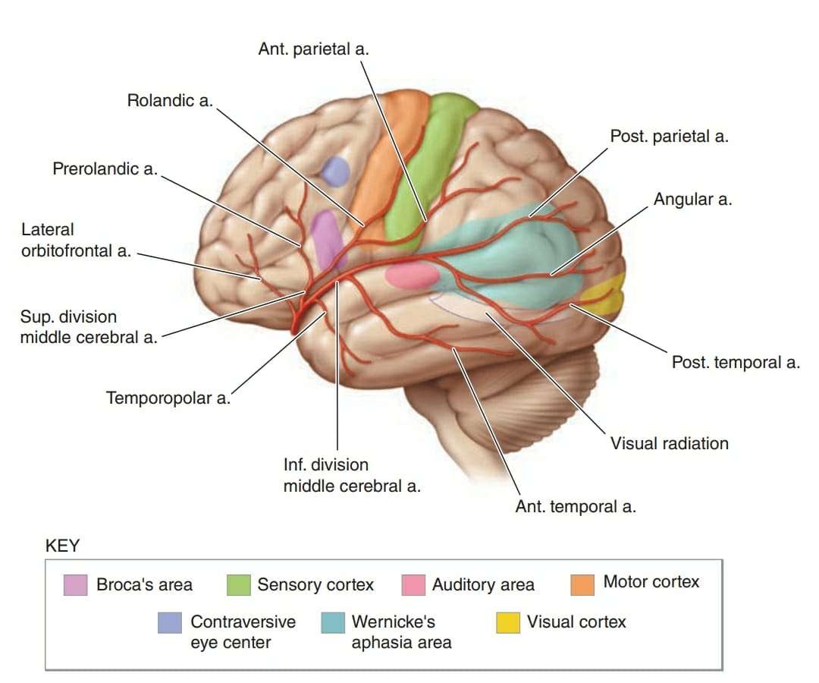
MCA

Slide 11
Anterior cerebral artery
-divided into A1(no deficit due to collaterals)
A2-supplies paracentral lobule(urinary incontinence),suppl motor area(primitive reflexes),pre frontal area(antisocial behaviour) & c/l LL weakness
-if both A2 arise from single stem-both hemisphers affected
-A1 supplies-5A’s anterior hypothalamus,anterior limb of IC,ant perforating substance,ant inferior part of caudate nucleus,amygdala
Anterior choroidal artery:
-It supplies posterior limb of IC
-C/L hemiplegia,hemianaesthesia,homonymous hemianopia

Slide 12
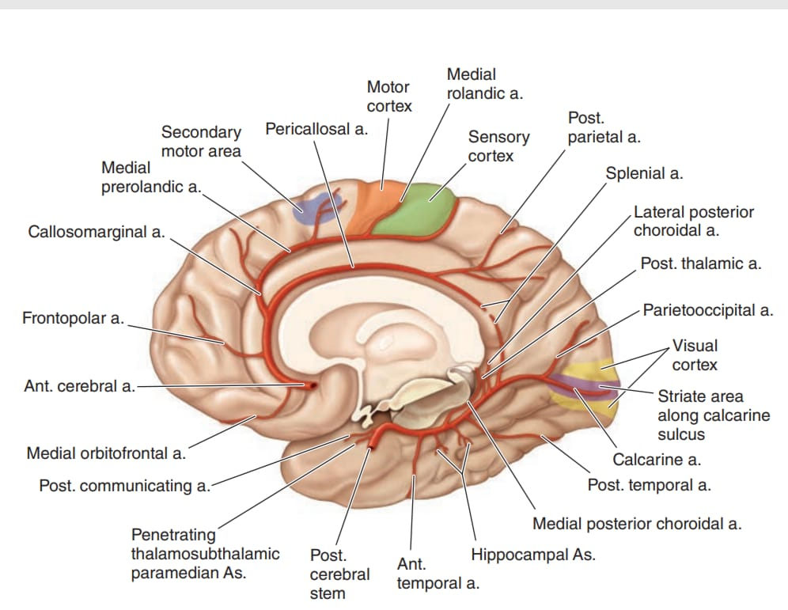
ACA

Slide 13
Posterior circulation:
-it is by 2 vertebral artery,basilar artery,paired PCA
-PCA P1 supplies midbrain-midbrain syndromes
subthalamus,thalamus-C/l hemisensory
loss,burning pain(dejerine roussy syn)
P2 supplies medial temporal,hippocampus
- memory disturbance(dominant spher)
occipital lobe-C/L homonymous
hemianopia without sparing macula
splenium-alexia without agraphia
-Anton’s syndrome:b/l infarct in PCA –cortical blindness
-Balints syndrome:infarction due to low flow in watershed
palinopsia,asimultanagsia

Slide 14
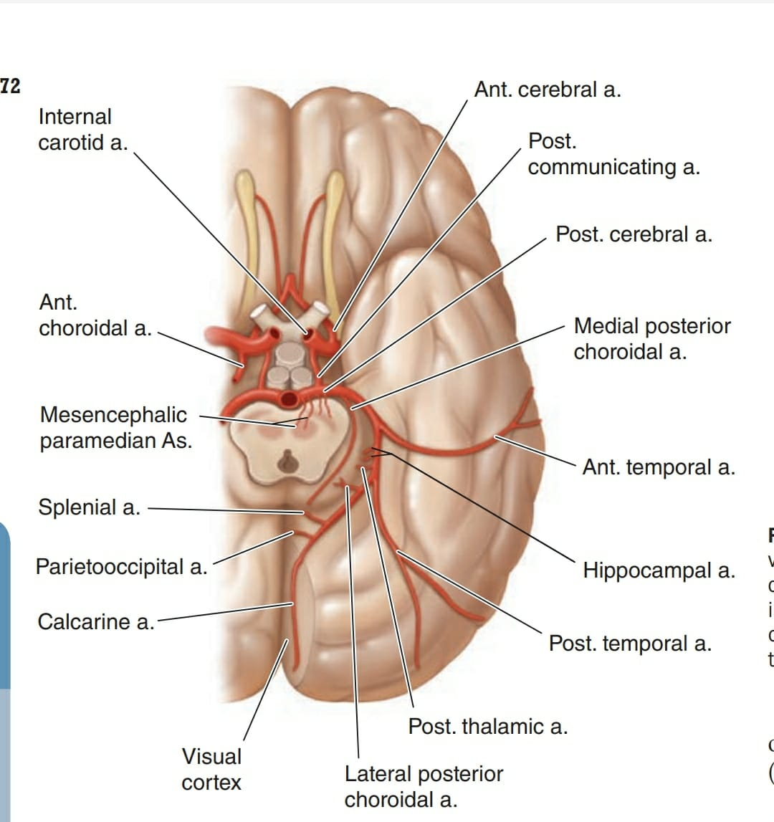

Slide 15
Vertebral & posterior inf cerebellar artery:
-VA supply brainstem & cerebellum
-PICA-supplies lateral medulla-lateral medullary
syndrome
-rarely medial medullary syndrome
-Cerebellar infarction-resp arrest,hydrocephalus,central
herniation,unsteady gait
Basilar artery:
-supplies pons &superior cerebellum
-CST,CBT,STT,CN nuclei are affected-results in locked in state

Slide 16
Brainstem syndromes:-
mid brain-1)weber syndrome
2)claude
3)benedicts
4)nothnegal
Medullary-1)medial medullary(Dejerine syn)
2)lateral medullary(wallenburg syn)

Slide 17
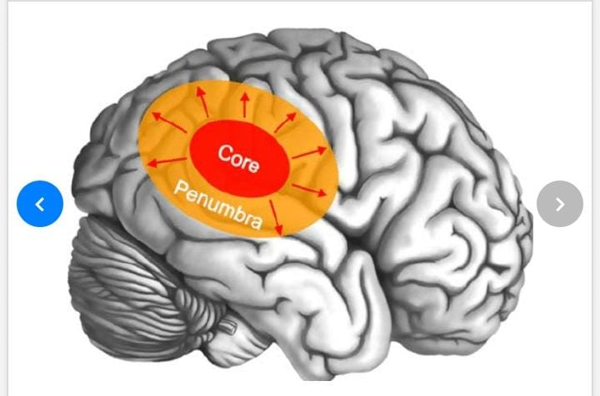
Ischaemic stroke:-
CBF-normal=54ml/100gm/min
if 20ml/min Ischaemia +,Infarction – {TIA}
if 16-18ml/min- Infarction –{CVA}
if 0ml/min for 4-10 min-neuronal death
Pneumbra: ischaemic but reversibly dysfunctional tissue surrounding area of infarction

Slide 18
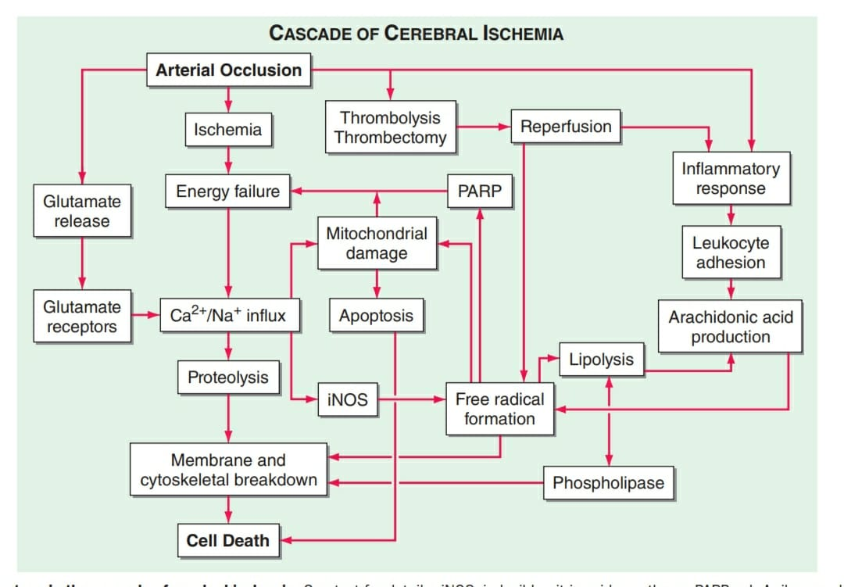

Slide 19
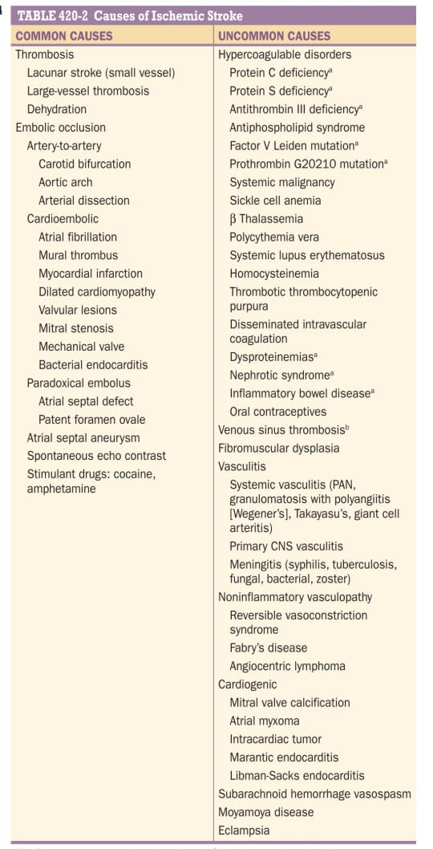

Slide 20
Small vessel stroke:
-Lacunar infarction-following atherothrombotic or
lipohyalinotic occlusion of small arteries
-It accounts for 20% of all strokes
Pathophysiology: MCA stem,circle of willis,VA,BA all
give braches that penetrate deep into grey & white
matter of cerebrum & brainstem
-Thrombosis of these causes small infarcts(Lacunes)
-HTN & age are risk factors
CF:-1)pure motor hemiparesis-post limb of IC
2)pure sensory-ventral thalamus
3)ataxic hemiparesis-ventral pons or IC
4)dysarthria & clumpsy hand-ventral pons or genu IC

Slide 21
Risk factors for stroke:
-HTN,Atrial fibrillation,diabetes,smoking,hyperlipidemia,
asymptomatic carotid artery stenosis,alcohol,physical
inactivity,increasing age
Transient ischaemic attack(TIA):
-episode of stroke symptoms last briefly i.e <24hrs but most TIA’s last for 1 hr
-TIA arise from emboli to brain or insitu thrombosis of intracranial vessel
-Risk of stroke after TIA ~10-15% in 1st 3months,most events occuring in 1st 2 days.This risk is estimated using ABCD2 score
-improvement characteristic of TIA is C/i thrombolysis
-rtPA is given
-Aspirin+clopidogrel is given to prevent stroke after TIA

Slide 22
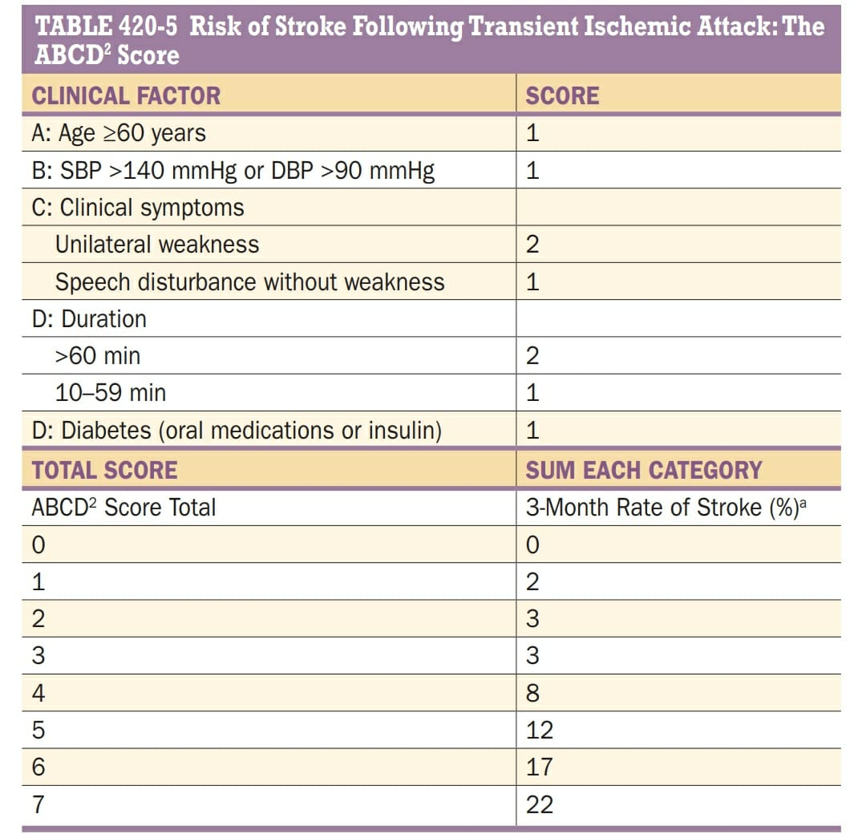

Slide 23
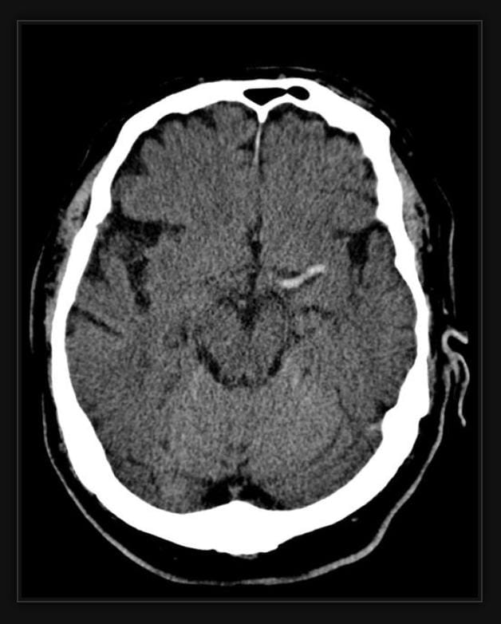
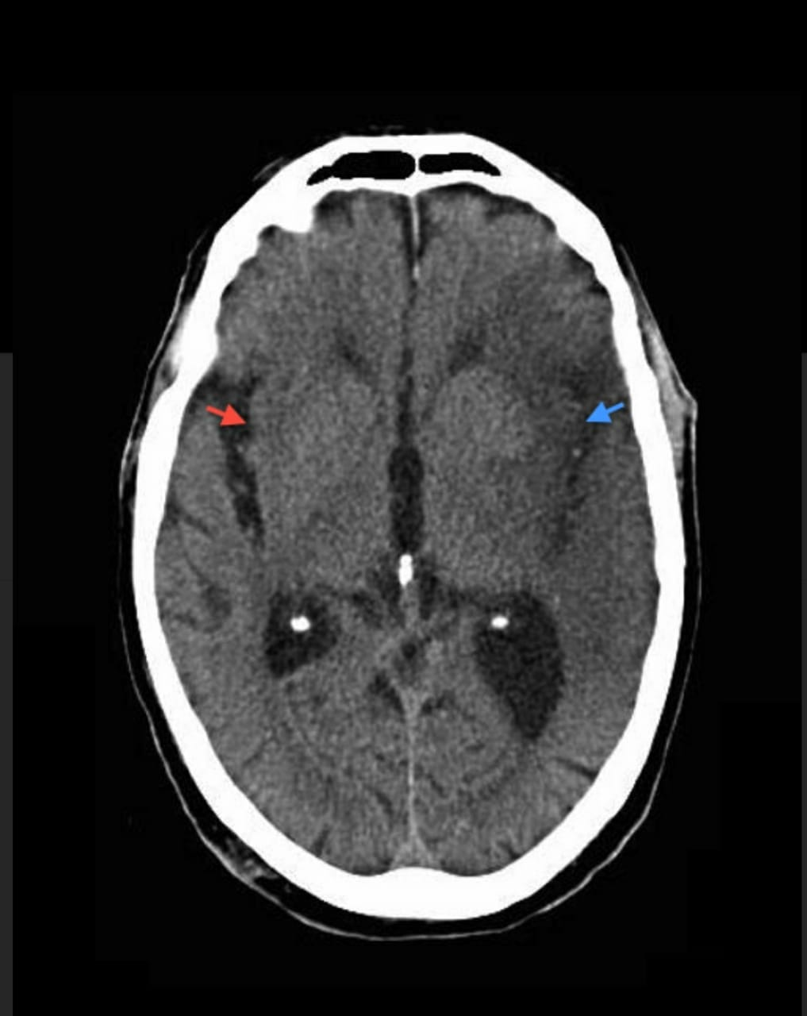
Investigations:
1) Plain CT-to rule out bleed,infarct=black
1st 6hrs –hyperdense MCA,6-48hrs – loss of insular ribbon sign,>48hrs- infarct formed

Slide 24
CECT-contrast enhancement of subacute infarcts &
visualises venous structures
CT angiography-iv iodinated contrast –visualises
cervical,intracranial arteries and veins.
-it helps in identification of pneumbra
3)MRI -infarct appears hyperintense(white)
-to know extent & location of infarct
Diffusion weighted MRI & FLAIR(fluid attenuated
inversion recovery image)-more sensitive for infarct
ADC(apparent diffusion cofficient) calculaed from
DWMRI
Perfusion weighted MRI-pneumbra is easily found

Slide 25
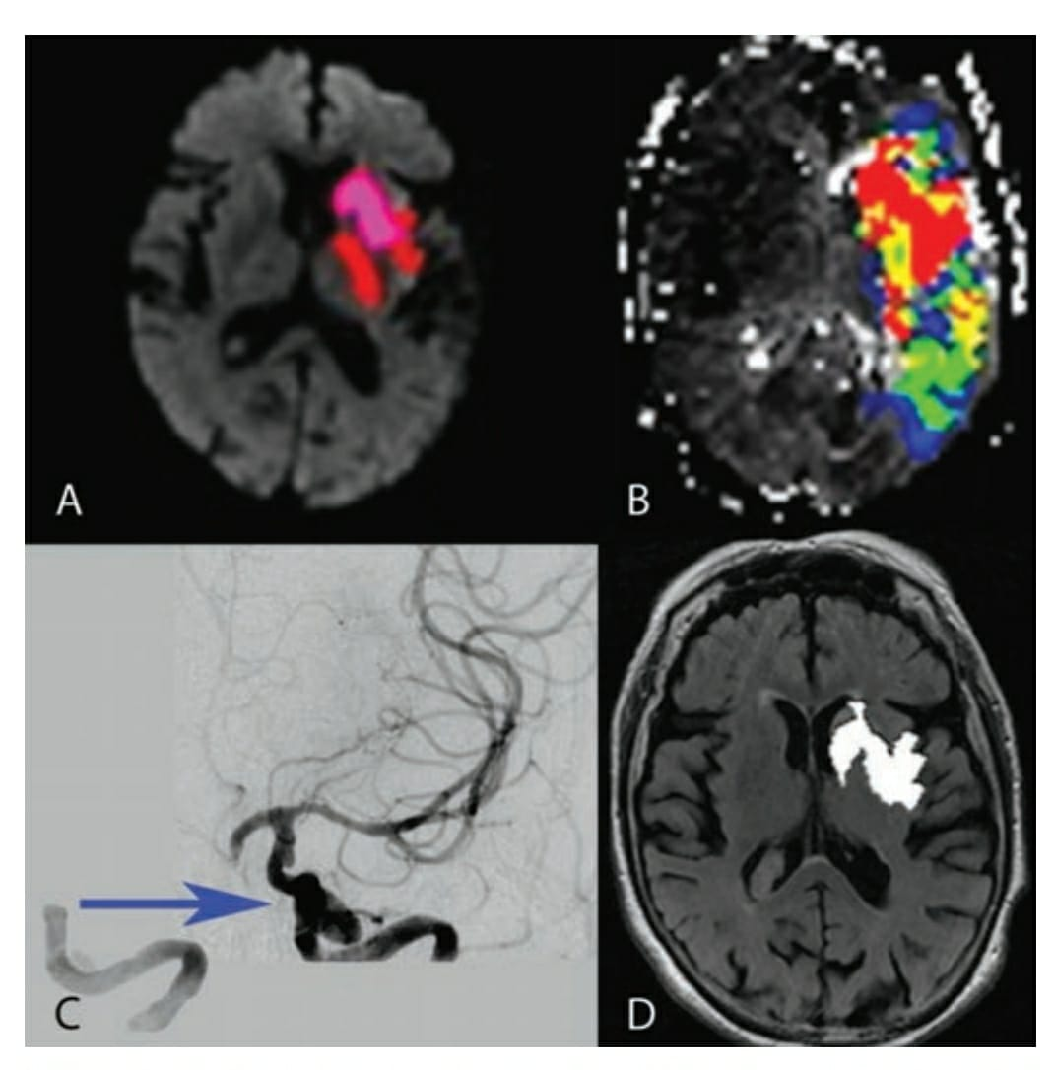
DWMRI
FLAIR

Slide 26
CT brain
DWMRI
normal hyperintense
no further invx
ADC perfusion MRI
hypointense MR angio
(acute case)
endovascular invn Accesible site not
IV thrombolysis

Slide 27
Differential diagnosis-
Seizures-h/o convulsions @ onset
Intracranial tumors
Migraine-visual symptoms +,sensory &motor deficit occurs after minutes
Metabolic encephalopathy-fluctuating mental status without focal neurological findings

